Slide 1
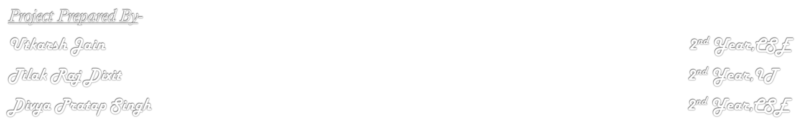

The Vikings
Presents
The Desktop Voice Assistant

Slide 2
Contents
About the DAVID
Earlier Work in the Same Field
Tools Required for the Working
Applications of DAVID
Methodology for the Formation
Functioning of the DAVID
Conclusion

Slide 3

DAVID!!
DAVID is an ARTIFICIAL DESKTOP VOICE ASSISTANT which is formed for the simplicity for the desktop user. DAVID can perform many of the basic functions and can follows many of the given instructions. DAVID can even can give voice output depending upon the demand.
DAVID is formed by using PYTHON as the basic language for the formation of the structure of the assistant. DAVID works over the internet and the browser as Google.
DAVID also represent the work on MACHINE LEARNING that is it shows the machine to user interface and NATURAL LANGUAGE PROCESSING(NLP) that is it shows how can machine can receive and recite instruction in the language that is easily understandable by the user.
As earlier Cortana was formed by Microsoft as a desktop assistant but was discontinued its use because of its malfunctioning and safety issues. So DAVID is one of the prototype for effective and efficient working as a desktop assistant.

Slide 4
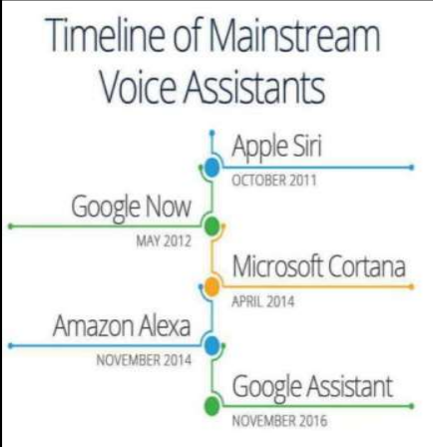




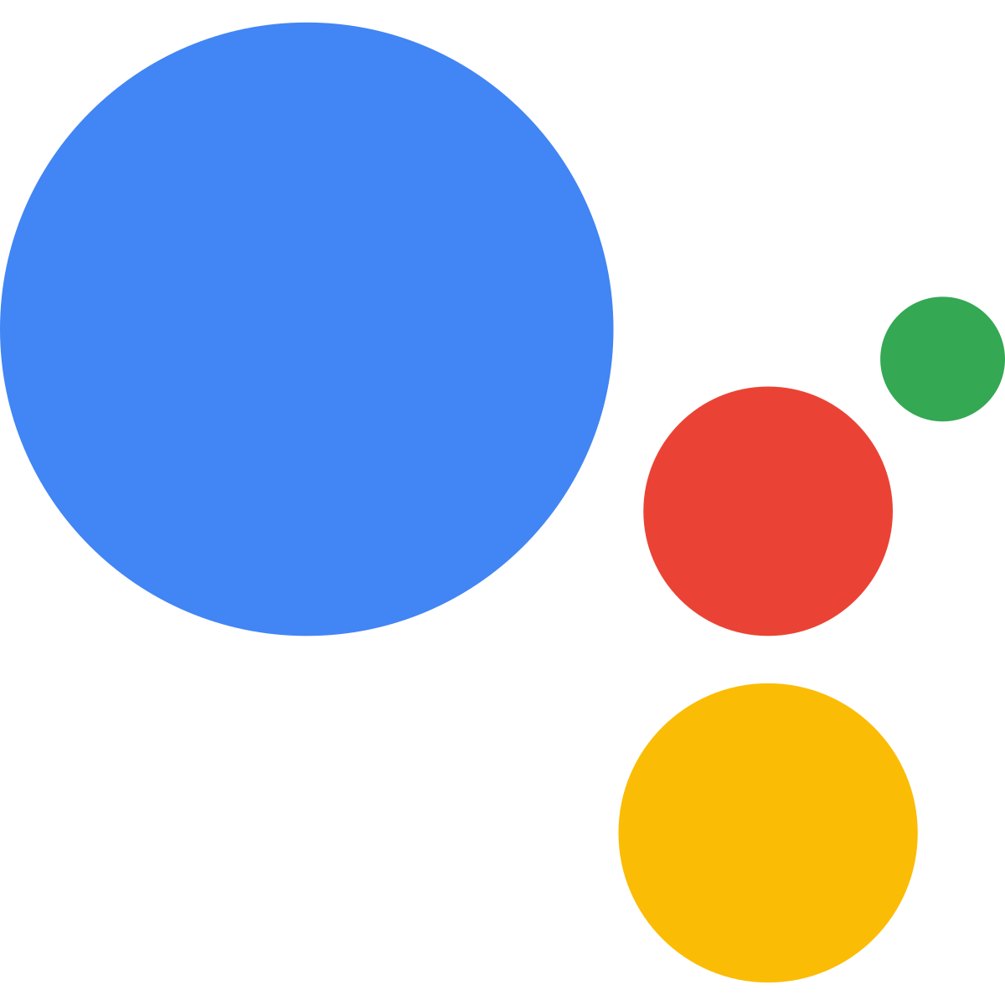

Earlier Work
This is the first voice assistant which is available for only IOS mobile phone users.
This is the first voice assistant which is available for ANDROID mobile phone users. This was further discontinued.
First voice assistant for the desktop, But this service is further discontinued.
First mobile voice assistant which is in the form of speaker.
Voice assistant for the ANDROID mobile phones users.

Slide 5
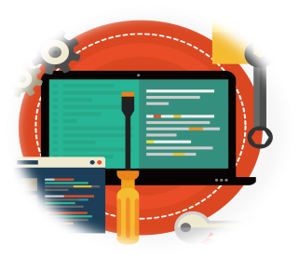
Tools required
Python- We use python as a programming language for building the application on the compiles as PyCharm and Visual Studio Code.
pyttsx3- It is a text-to-speech conversion library in Python. It is an external module
speech recognition- Speech recognition means that when humans are speaking, a machine understands it. We have used so as to use Google Speech API in Python to make software which is used to run machines on command. It is an external module.
web browser- To perform Web Search. This module comes built-in with Python.
OS- The OS module in Python provides functions for interacting with the OS. This an build an module.
play sound- It is an external library which helps us to play sound over the compile. This module this module is downloaded externally.
date time- It comes built into Python, which help us to search the command given regarding the date and time.
Wikipedia- We all know Wikipedia is a great and huge source of knowledge .We have used the Wikipedia module to perform a Wikipedia search. This external module.

Slide 6
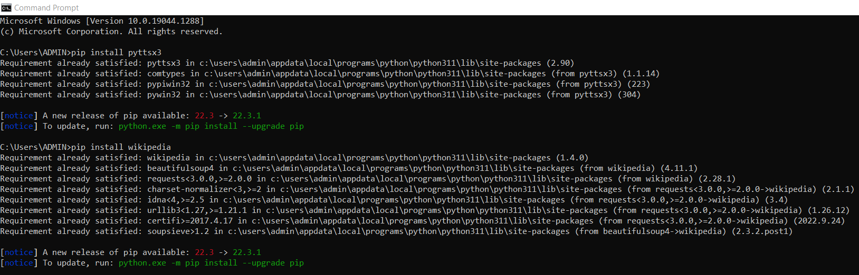
Installing of the modules

Slide 7


Methodology for Processing
Installing of Modules
Voice Input
Recognition of the Command
Presenting the Data
Collecting Data
Extracting Data

Slide 8
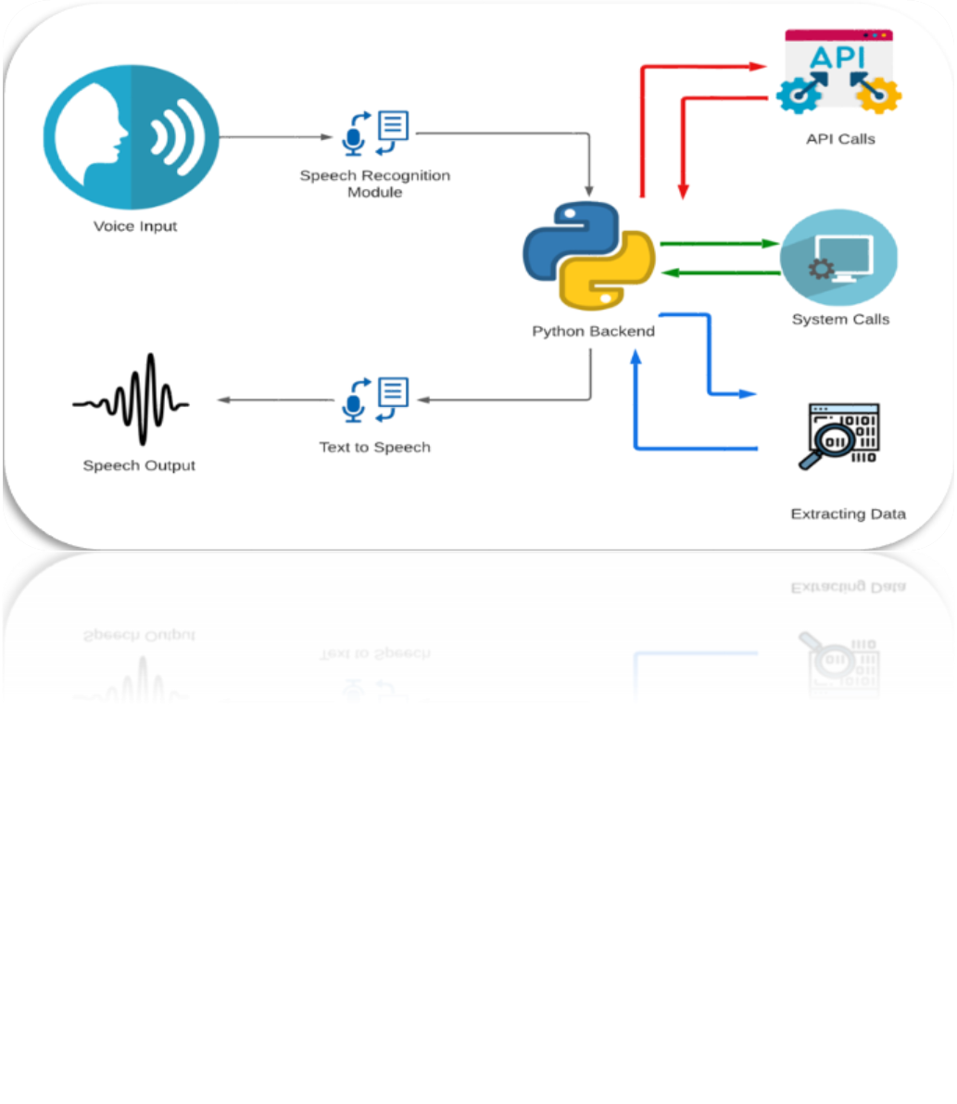
Functioning of the Project

Slide 9
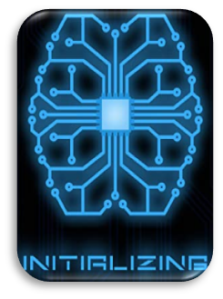
Initialization
In very beginning of the code file. In this step we install and use modules which as available and which can be downloaded easily.
Modules which we have used are:
pyttsx3
Speech Recognition
Date time
Wikipedia
Web Browser
OS
Play Sound

Slide 10
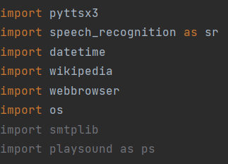
Modules Used

Slide 11
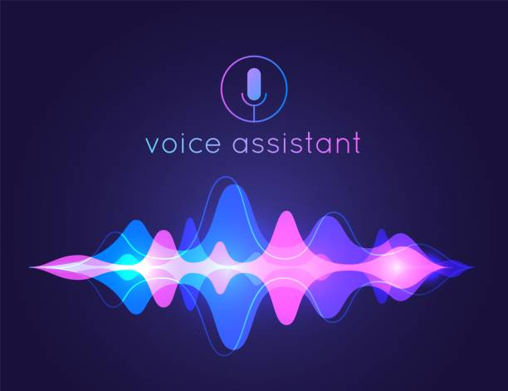
Voice Recognition Ability
It is the first element for the processing of the project that is it detects the speech or voice command given by the user.
In this the users can speak and obtain the text in exchange of voice input from the special program organized on computer network server at the information center from the microphone which is temporarily stored in the system.
Once digitized, many models can be used to transcribe the audio to text. The same text is then received and sent to the voice assistant program.
The whole program is written on python Backend. The python Backend work on getting the output in exchange of voice input provided by the users through speech recognition module and then identifies whether the command given is Context Extraction, API Call and System call.

Slide 12
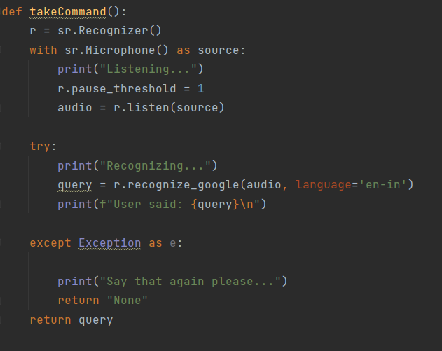
Voice Ability

Slide 13

Commanding options available
In this step we give command to the assistant DAVID.
In this assistant we can give commands or the instructions like
We can have NORMAL CONVERSATION with the assistant.
Assistant can help us to tell the TIME.
We can give command to OPEN apps or websites like Google or YouTube
We can PLAY MUSIC from library.
We can have a Funny Chats like for asking a JOKE.
We can SEARCH any INFORMATION by using the assistant.

Slide 14
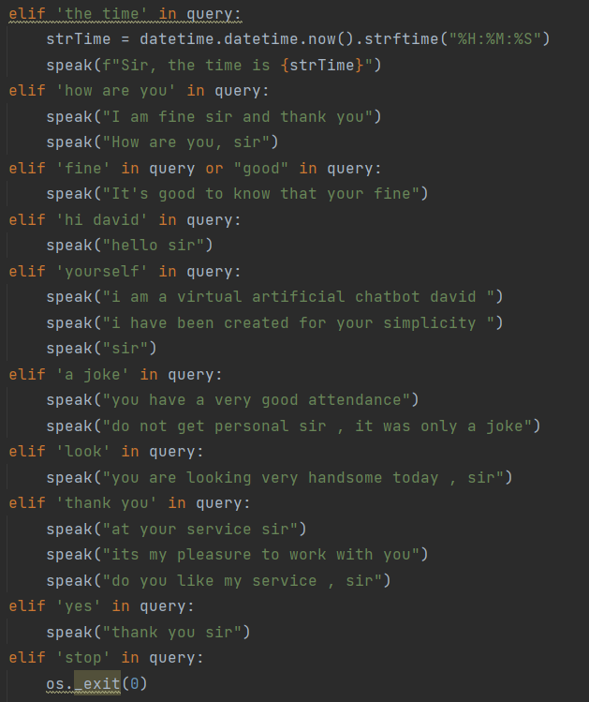
Command Options

Slide 15
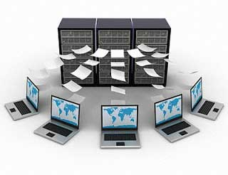
Collection of Data
In this step the assistant basically collect the data related to the instruction given.
Whole of the functioning of the assistant is to find the relevant files and the modules which are similar to the instruction given.
The system will gather multiple of files and information regarding the instruction given.
Application Programming Interface(API) is software intermediatory and the work of the API is to allow two applications to talk each other.
In other words, API is the message passer that delivers the users request to the provider and then send the response back to users and help us to collect data

Slide 16
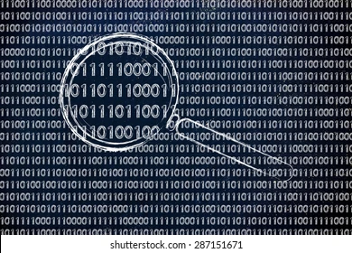
Content Extraction
Context Extraction is use to automatically extract structured information from unstructured or semi-structured machine-readable documents.
The majority of the time, such activity entails using Natural Language Processing to interpret human readable texts.
Activities like automatic annotation and content extraction out different images/video/audio could be seen as content extraction.
Basically in this step the assistant or the Python back end short list the relatable and reasonable data which can be presented to the user.
For example of opening of the YouTube or the Playing the Music.

Slide 17

answering
In this stage the system present the data to the user.
The assistant can present the data by displaying on the screen or by verbally saying it.
The assistant again use the modules for speaking and displaying.
Data can also be represented in the form of text depending upon the output.
Data can be represented by successful extraction from different websites.
Data can be also represented in the form of the image depending upon the command given and the output.

Slide 18
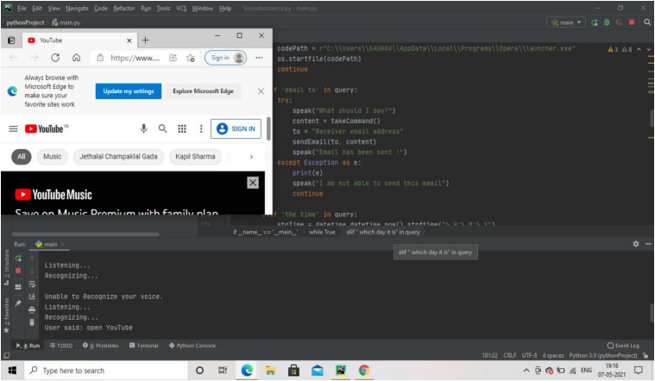
Presentation of data

Slide 19

Conclusion
In this project we’ve got mentioned regarding Personal Virtual Assistant for Windows Using Python namely DAVID.
DAVID can make life easier for humans. Virtual assistant is that the flexibility to contract for simply the services they have.
This project also facilitates visually impaired and physically challenge people.
The results show that these techniques could use effectively for voice recognition purposes. We have added more features like it will listen to the users’ voice only and will not be activated from environment noise.
The modular nature of this project makes it easy to understand and more flexible. We are able to add more features in the program without disturbing the functionalities.
All the packages needed in python programming language has been installed and the code was implemented using VS Code Integrated Development Environment (IDE). The python version used for this project was 3.x and the data of different noises also taken from the environment

Slide 20

More of DAVID!!
DAVID if further improved and installed on many system the it can give many more output and can perform many more operations like:
Provides 24/7 User Support
Eradicates Language Barriers
Helps Streamline Operations
Saves Time by Automating Repetitive Tasks
Aids Hand-free Operation
Removes many other Hardware Devices
Can be used for Booking Tickets
Used for Efficiency of the Work

Slide 21


